Slide 1

Using GPT API Models as Second Screener of Titles and Abstracts in High-Quality Systematic Reviews
Mikkel H. Vembye, PhD
SRMA SIG, 2024.11.15

Slide 2
Why use AI for screening in systematic review?
For Quality Reasons/To Improve Quality
Human screeners overlook relevant studies for various reasons. Therefore, state-of-the-art is to conduct manual double-screening. However, this is costly and many research groups cannot afford double-screening.
Researchers most often limit their database searches so that they yield a number of studies that has a manageable size for humans to screen. However, this increases the risk of overlooking relevant studies.
Overlooking relevant studies at this initial review stage can be consequential, leading to substantially biased results.
For Resource Reasons/To Reduce Resources
Screening large amounts of references slow the review process as it can take an unmanageable amount of time. In our Campbell reviews, we spend approximately 3–5 months on this process, and even more in our large reviews.
It is tedious, manual work that can be hard to finish.
Some reviews cannot be completed because they require screening of too large a number of references. This problem will only grow over time as the number of references in research databases increases.
Notes:
AI tools can accommodate both type of issues

Slide 3
What we have test and developed
We have tested the use of OpenAI’s GPT (Generative Pre-trained Transformer) API (Application Programming Interface) models to screen titles and abstracts. As you will see in a moment, this is NOT the same as using ChatGPT!
To conduct this type of screening, we have developed the R package AIscreenR (Vembye, 2024)
Our preliminary results show that GPT API models at least perform on par with human screeners, even in very complex reviews with many inclusion criteria. I will come back to these results later in the presentation
So far, we have not yet encountered a case where we could not use this method.
Based on this, we suggest that GPT API models can be used as full secondary screeners in state-of-the-art reviews (for further details, see Vembye, Christensen, Mølgaard, & Schytt, 2024).

Slide 4
Why GPT API models and not just ChatGPT?

Slide 5
What do I mean by screening with a GPT model?
Let me demonstrate to give you a practical understand of this screening approach.

Slide 6
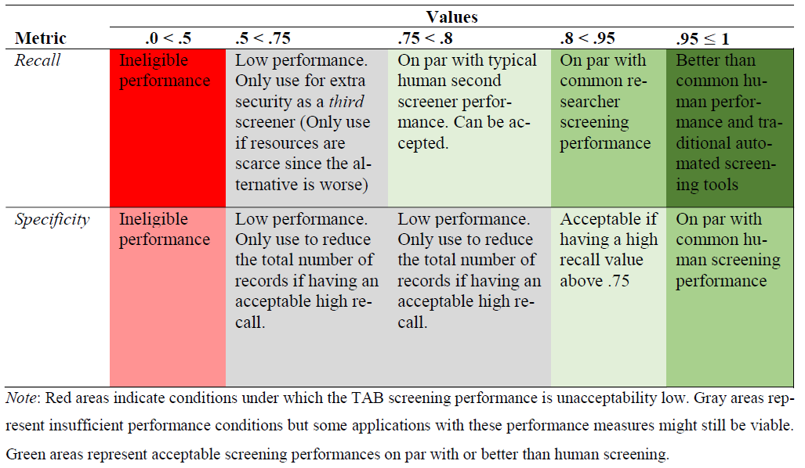
The benchmark scheme
In light of the typically human screening performances, we developed the following benchmark scheme. The aim is to help assessing screening performances of in general but also to judge when GPT screening is appropriate in high-standard reviews.

Slide 7
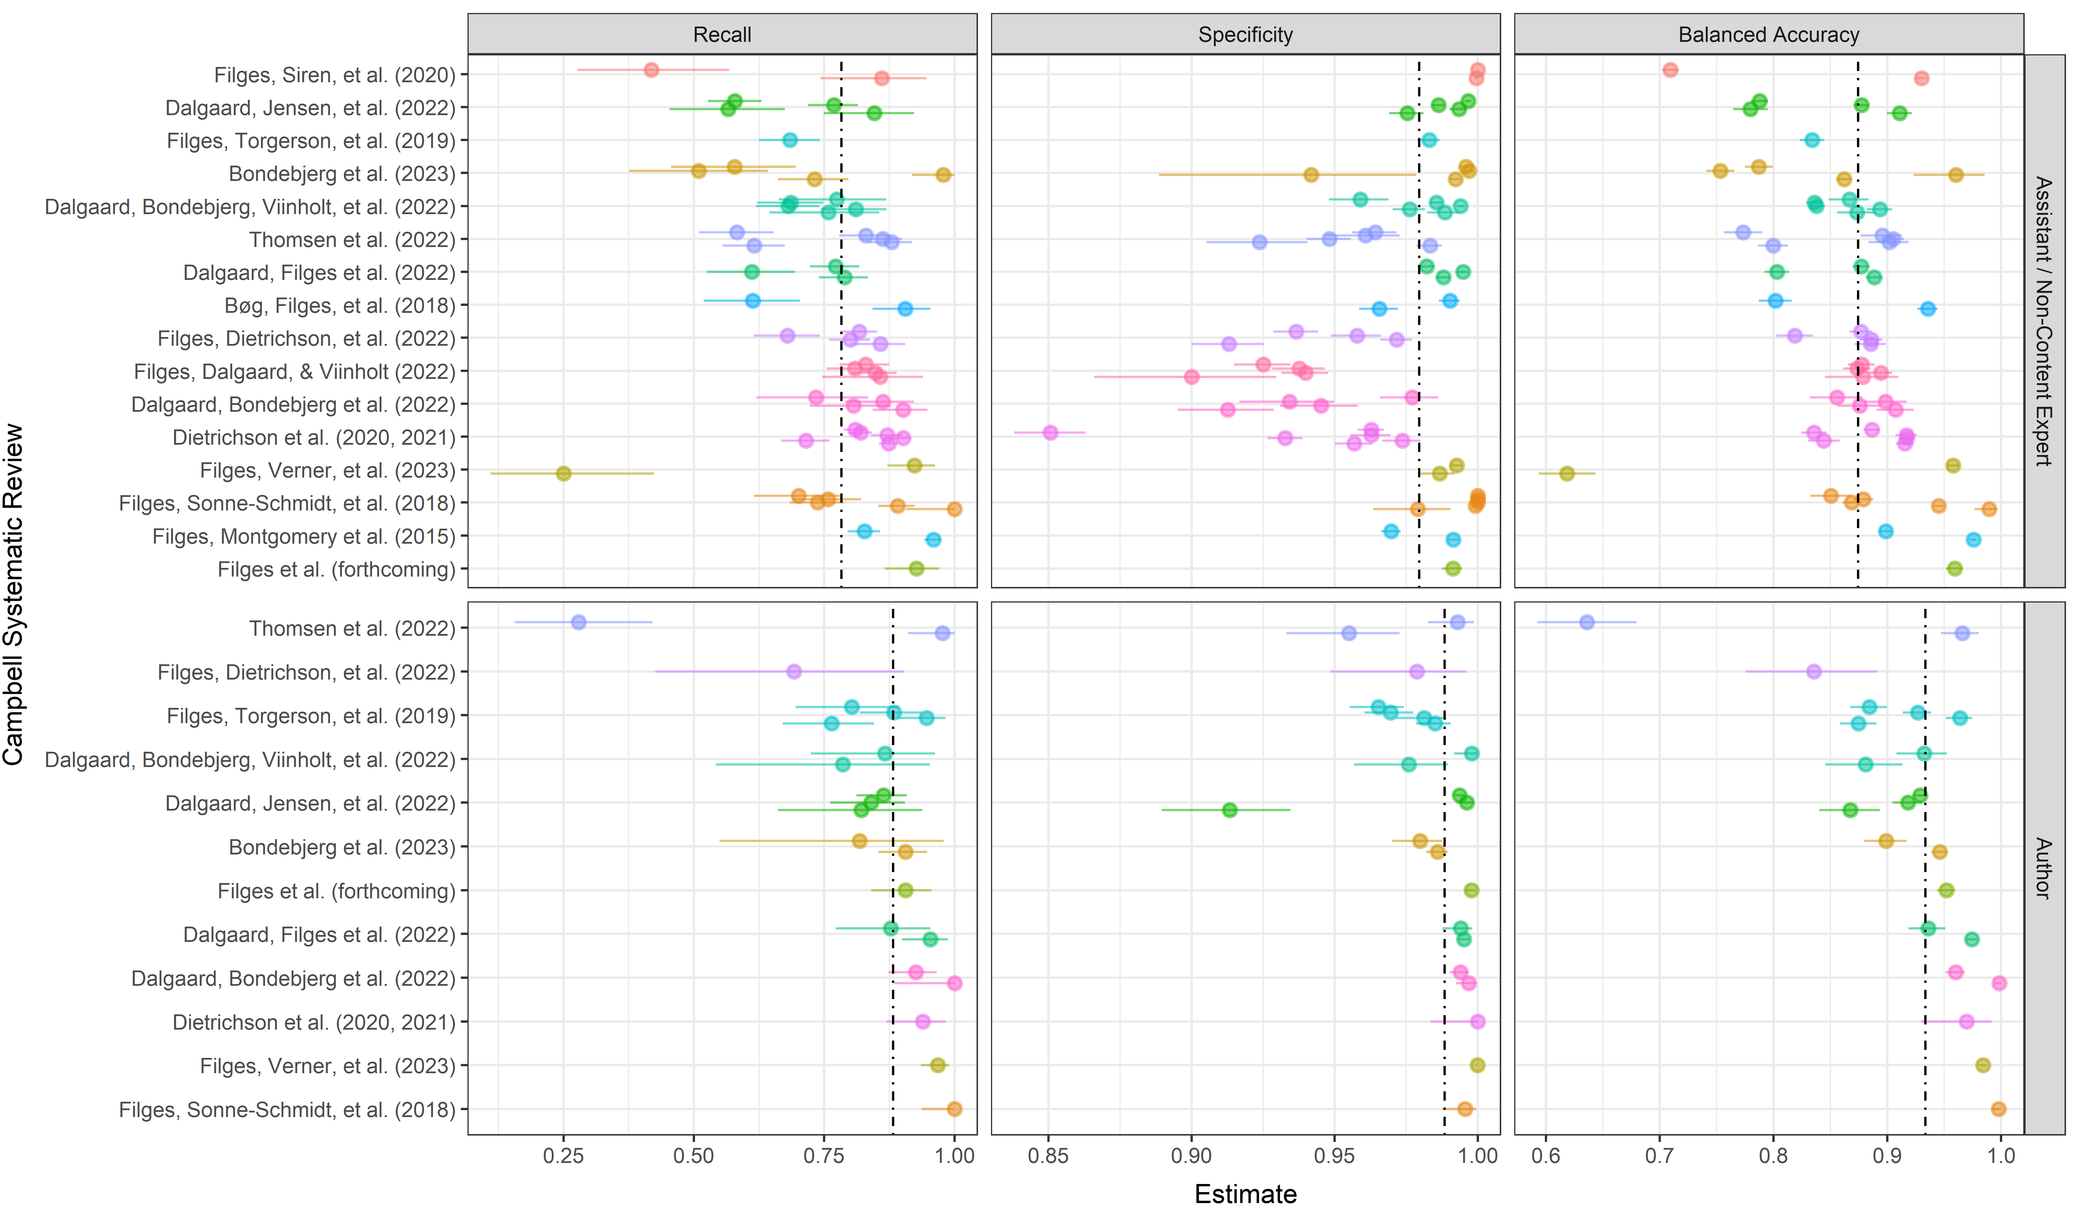
Typical human screening performance
To make fair comparisons between GPT and human screening, we mapped common human screening performances across 22 high-quality reviews. Hereto, we found the typical second screener to have a recall of 78.2%, 95% CI[74.7, 81.7] and specificity of 98%, 95% CI[96.6, 99.0].
Note: Dashed lines indicate the average estimated via the CHE-RVE model. Each point represent an individual screener within the given review
Notes:
Add what statistical approach we used.

Slide 8

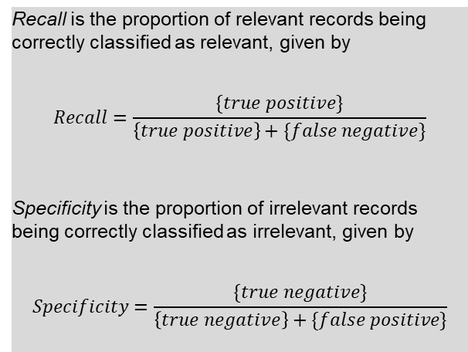
How generalizable is this approach?
We find that GPT API models can perform on par with or in some cases even better typical human second screeners in high-quality systematic reviews (Vembye et al., 2024).
We conducted three large-scale classification experiments with different levels of complexity in terms of the number of inclusion criteria.
In simple screening cases, we even find recall close to 100% and with a high specificity values (97.4%), as well.
In complex review settings, we find the GPT-4 model to yield a recall of 80%.
Yet, in complex review setting, the GPT-4 model is rather over-inclusive with a specificity of ~84%.
However, we argue this is not as problem as long as the recall is high (i.e., on par with humans) since a low specificity does not induce any bias to a review.
Recall is the proportion of relevant records being correctly classified as relevant, given by
$$Recall=\frac{\{true positive\}}{\left\{true positive\right\}+\{false negative\}}$$
Specificity is the proportion of irrelevant records being correctly classified as irrelevant, given by
$$Specificity=\frac{\{true negative\}}{\left\{true negative\right\}+\{false positive\}}$$
Notes:
Add gpt-4o-mini results

Slide 9

What we also do: standardization
To standardize this screening approach, we further developed
Common guidelines for when it is (and when it is not) appropriate to use GPT API models for title and abstract screening in high-quality reviews. These guidelines are primarily based on the benchmark scheme.
A workflow for how to configure a reliable screening, including how to test and develop prompts. Hereto we introduce multiple-prompt screening, i.e., making one prompt per inclusion criteria.
The AIscreenR R package (Vembye, 2024). This (among other things) allows the user to screen with multiple prompts and with parallel processing. To exemplify, we have been able to screen 14.000 references with 1 prompt and the gpt-4o-mini in less than 30 minutes (prize, $1.45 USD). The package also includes a practical/user-friendly step-by-step tutorial.

Slide 10
To recap: Advantages of this screening method
Rigorous treatment of all titles and abstracts
It is fast
It is cheap
You can guard against human drifting.
Extra ensurance that you have found all revelavant records.
Agnostic to data imbalance [i.e., INSERT]

Slide 11
Limitation
In theory it is prompt sensitive
Off-the-shelf method. We got desk rejected in RSM for this reason.
Environmental impact. This hard to fully assess but many people have concerns about this.

Slide 12
Concerns for future research
Test it with local models. This would freeze the efficacy of this approach and increase transparency of this approach. Our paper was desk rejected by RSM because we draw on an off-the-shelf model that can change over time.
Consider how best to combine traditional automated screening tools with GPT API screening. For instance can GPT API models play a role in validating stopping rules when using priority screening algorithms?
How to take advantages of fine-tuning
Implementation in standard references tools such as Meta-Reviewer, EPPI Reviewer, Covidence, etc.

Slide 13
References
Alshami, A., Elsayed, M., Ali, E., Eltoukhy, A. E. E., & Zayed, T. (2023). Harnessing the power of ChatGPT for automating systematic review process: Methodology, case study, limitations, and future directions. Systems, 11(7), 351. https://doi.org/10.3390/systems11070351
Gargari, O. K., Mahmoudi, M. H., Hajisafarali, M., & Samiee, R. (2024). Enhancing title and abstract screening for systematic reviews with GPT-3.5 turbo. BMJ Evidence-Based Medicine, 29(1), 69 LP – 70. https://doi.org/10.1136/bmjebm-2023-112678
Guo, E., Gupta, M., Deng, J., Park, Y.-J., Paget, M., & Naugler, C. (2024). Automated paper screening for clinical reviews using large language models: Data analysis study. J Med Internet Res, 26, e48996. https://doi.org/10.2196/48996
Issaiy, M., Ghanaati, H., Kolahi, S., Shakiba, M., Jalali, A. H., Zarei, D., Kazemian, S., Avanaki, M. A., & Firouznia, K. (2024). Methodological insights into ChatGPT’s screening performance in systematic reviews. BMC Medical Research Methodology, 24(1), 78. https://doi.org/10.1186/s12874-024-02203-8
Khraisha, Q., Put, S., Kappenberg, J., Warraitch, A., & Hadfield, K. (2024). Can large language models replace humans in systematic reviews? Evaluating GPT-4’s efficacy in screening and extracting data from peer-reviewed and grey literature in multiple languages. Research Synthesis Methods. https://doi.org/10.1002/jrsm.1715
Syriani, E., David, I., & Kumar, G. (2024). Screening articles for systematic reviews with ChatGPT. Journal of Computer Languages, 80, 101287. https://doi.org/10.1016/j.cola.2024.101287
Tomlinson, B., Black, R. W., Patterson, D. J., & Torrance, A. W. (2024). The carbon emissions of writing and illustrating are lower for AI than for humans. Scientific Reports, 14(1), 3732. https://doi.org/10.1038/s41598-024-54271-x
Vembye, M. H. (2024). AIscreenR: AI screening tools for systematic reviews. (0.1.0). CRAN. https://doi.org/10.32614/CRAN.package.AIscreenR
Vembye, M. H., Christensen, J., Mølgaard, A. B., & Schytt, F. L. W. (2024). GPT API Models Can Function as Highly Reliable Second Screeners of Titles and Abstracts in Systematic Reviews: A Proof of Concept and Common Guidelines. Open Science Framework. https://doi.org/10.31219/osf.io/yrhzm

Slide 14
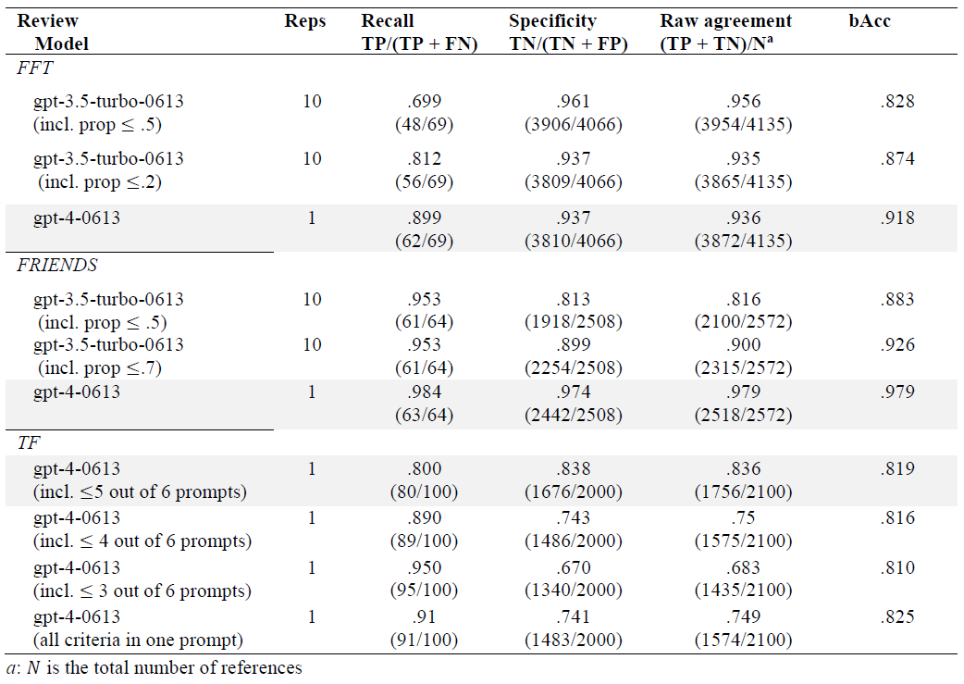
Appendix – all results

